Slide 1
2048
Jing Wang (Jane)
CS 5002 finial project

Slide 2
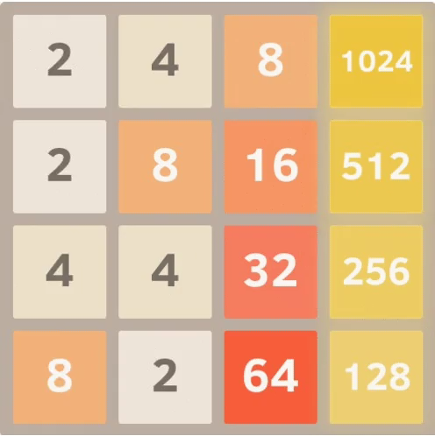
Goal is 2048
4*4 board
Random 2(80%) or 4(20%)

Slide 3
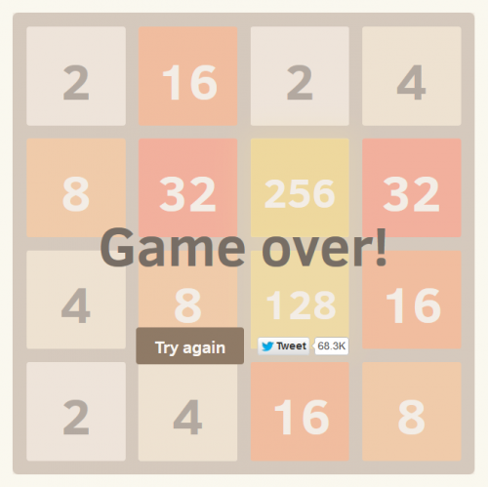
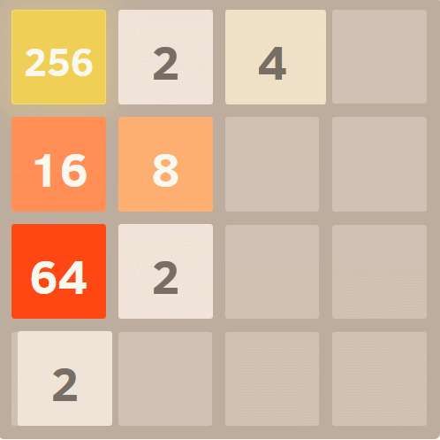
Can’t move ”up” “left”

Slide 4
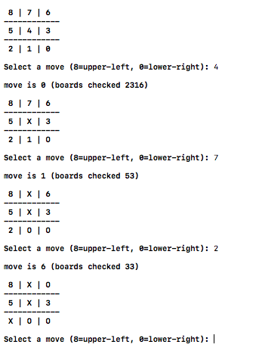
Why I want to make it in C
The tictac game
Each input cell number-> new board
Waiting for the next number
Stop: win or lose
The 2048 game
Each direction -> new board
Waiting for the next direction
Stop: (win) 2048 or (lose) No move

Slide 5
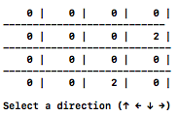
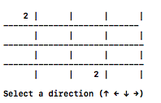
Creating the board
int board[16] = {0};
sprintf(string[i], "%4d", board[i]);
printf(" %4s | %4s | %4s | %4s | \n",
string[0],
string[1],
string[2],
string[3]);

Slide 6
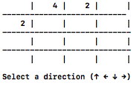
Put random number
#include <time.h>
#include <stdlib.h>
srand((unsigned int)time(NULL))
int r = rand();
int newnumber[5] ={4, 2, 2, 2, 2};
4: 20% 2: 80%
int r = rand()%5;

Slide 7
Get arrow key as input
getch()
get a single character from the console
By pressing one arrow key getch will push three values into the buffer:
'\033'
'['
'A', 'B', 'C' or 'D'
if (getch() == 239) {
getch();
switch(getch()) {
case 128:
printf("up");
break;
case 129:
printf("down");
break;
case 130:
printf("left"); break;
case 131:
printf("right");
break;
}
My system:
239
156
128, 129, 130, 131

Slide 8
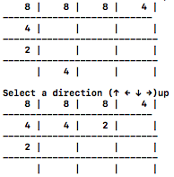
Move the number towards directions
int shift_cell(int board[],int dir[4][4])
int combine_cell(int board[],int dir[4][4])
for(int i = 0; i<4; i++){
for(int j = 1; j<4; j++){
int testup[4][4] = {{0, 1, 2, 3},
{4, 5, 6, 7},
{8, 9, 10, 11},
{12, 13, 14, 15}};

Slide 9
4 directions-representing matrix
int up[4][4] =
{{0, 1, 2, 3},
{4, 5, 6, 7},
{8, 9, 10, 11},
{12, 13, 14, 15}};
int down[4][4] =
{{12, 13, 14, 15},
{8, 9, 10, 11},
{4, 5, 6, 7},
{0, 1, 2, 3}};
int left[4][4] =
{{0, 4, 8, 12},
{1, 5, 9, 13},
{2, 6, 10, 14},
{3, 7, 11, 15}};
int right[4][4] =
{{3, 7, 11, 15},
{2, 6, 10, 14},
{1, 5, 9, 13},
{0, 4, 8, 12}};

Slide 10
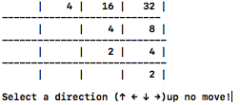
Can’t move in certain direction
int combine_cell(int board[],int test[4][4])
Can combine
int shift_cell(int board[],int test[4][4])
Can shift
Moveboard(int board[],int test[4][4]
return shift||combine;
Move in that direction

Slide 11
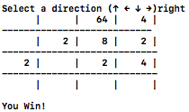
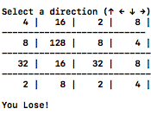
Win and lose
#t
for(int i = 0; i<MAX; i++){
if (board[i] == GOAL) {printf("\nYou Win!\n\n"); return 1;}
}
return 0;
Copy current board
if ((Moveboard(test_board, up))||
(Moveboard(test_board, down))||
(Moveboard(test_board, left))||
(Moveboard(test_board, right))){
return 0;
}
printf("\nYou Lose!\n\n");
return 1;
#f

Slide 12
Thank you!

